Slide 2
A
“News that inspired millions across the nation”

Slide 3
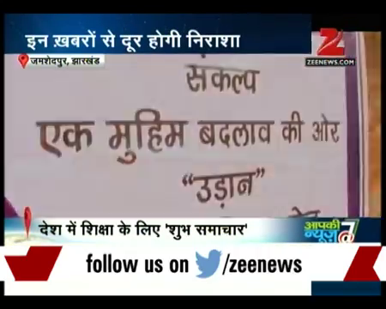

Slide 4
SANKALP FEATURED ON NATIONAL TELEVISION CHANNEL ZEE NEWS ON PRIME TIME IN THE PROGRAMME “AAPKI NEWS” ON 15 TH DEC 2015:7 PM

Slide 5
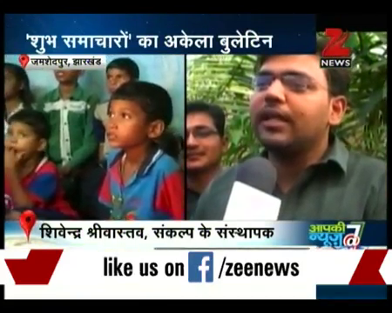

Slide 6
“When the work done over years gets national recognition”

Slide 7
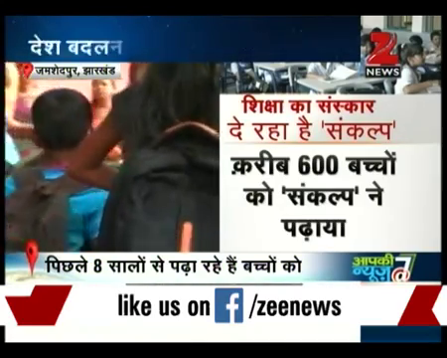
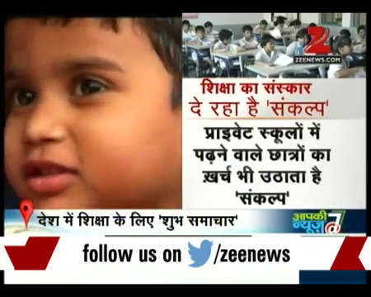
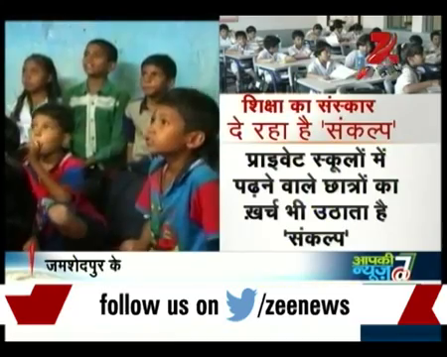

Slide 8
President, Sankalp Live on Zee News Highlighting Vision, Mission and Goal of Sankalp -A Pledge To Change

Slide 9
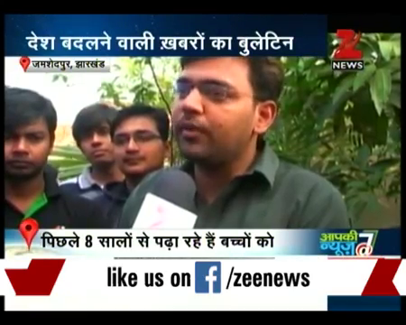
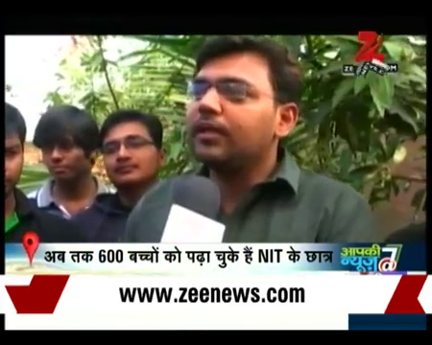
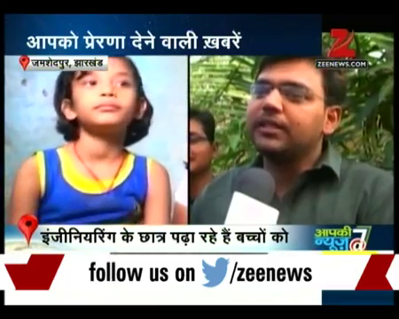
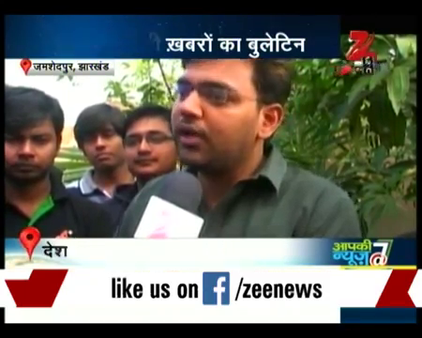

Slide 10
At theBattlefields-
ZeeNews@Sankalp Centres

Slide 11
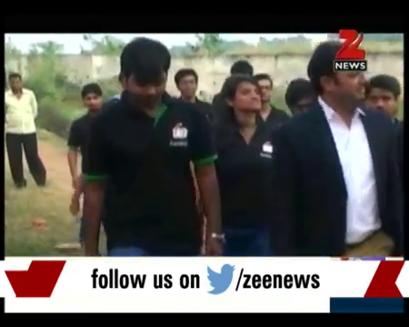
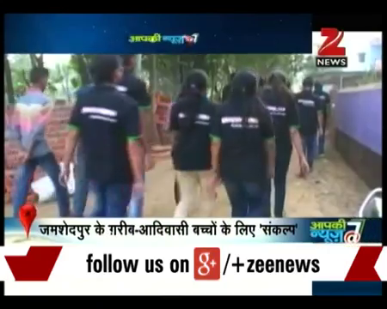
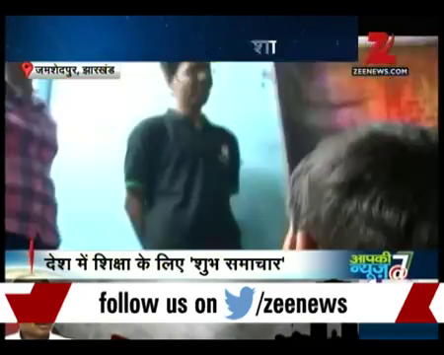
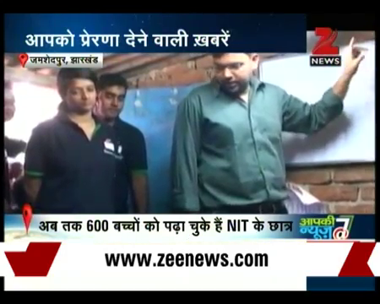

Slide 12
Zee News
Witnessing the revolution
@Sankalp Centres

Slide 13
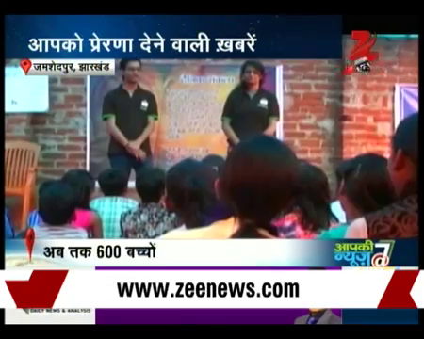
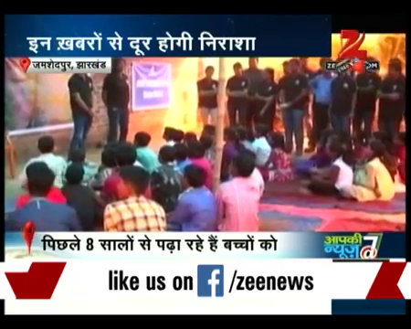
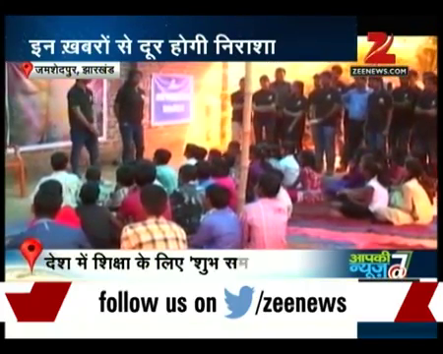
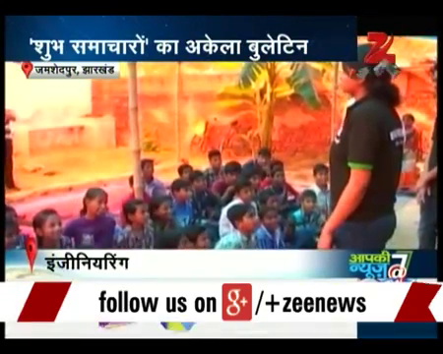

Slide 14
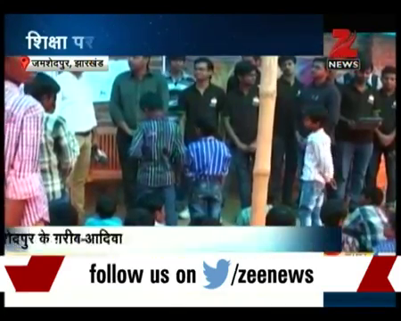
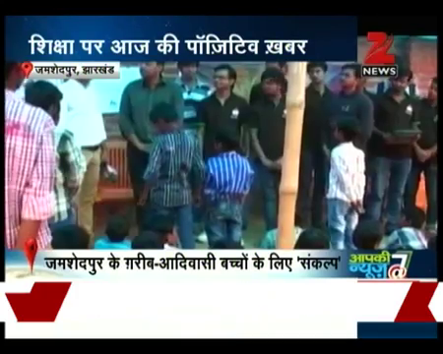
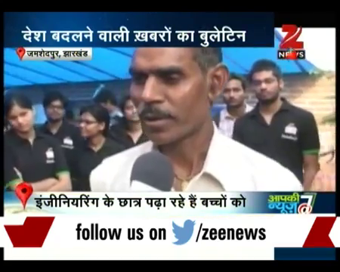
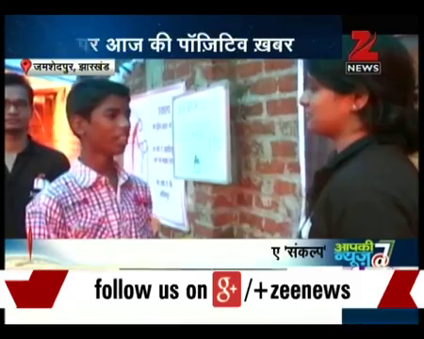

Slide 15
And the Zee News Coverage matters a lot
Because

Slide 17
A victory called
A
Pledge To Change

Slide 19
LET’S BE A PART OF THE JOURNEY

Slide 20
COME JOIN US !!!
You can donate at any our centres by just making a call to Sankalp-A Pledge to Change volunteers.
All our centres are Adityapur based and run 6 days a week
You may donate books from
Class 1-8- Course Text Books (Any Board)
Story Books
Unused stationery
Any other items like bag, toys, uniforms etc.
Relevant Contact Nos. Are
Subodh Kumar Das-9798756336
Mayank Aggarwal -9031975746
Suresh Pareek -7209632032
Vikas Dixit -9472706225

Slide 21
ACCOUNT DETAILS FOR SUPPORT
Sankalp Account Details
You can transfer funds online into our account:-
“SANKALP” A/C No.-31114719936
CIF No: 85757412911
IFSC Code: SBIN0001882
MICR Code: 831002004
Branch code: (1882)
Branch: SBI- RIT JAMSHEDPUR
You may also visit our website and pay through online link available over it.
www.sankalpnitjamshedpur.org

Slide 22
“You have not lived today until you have done something for someone who can never repay you.”
www.sankalpnitjamshedpur.org

